Slide 1
Online Retail Database
Elvis Bui and Haozhen Yang

Slide 2
Project Overview
This project models a simplified online retail system that allows customers to browse products, place orders, and process payments. It simulates the main data operations found in a small-scale e-commerce environment using data from the Kaggle UCI Online Retail dataset.
The system captures transactions, line items, customers, and payments, ensuring a normalized relational structure for future querying and reporting.

Slide 3
Actors and Responsibility
Actor | Responsibility
Customer | Browse and search products, create and pay for orders, and request refunds.
Catalog Admin | Manage product and category data, handle refunds.
Warehouse Staff | Fulfill orders and update shipment status.
Manager | View and analyze sales reports.
Payment Gateway | Process and confirm customer payments.

Slide 4
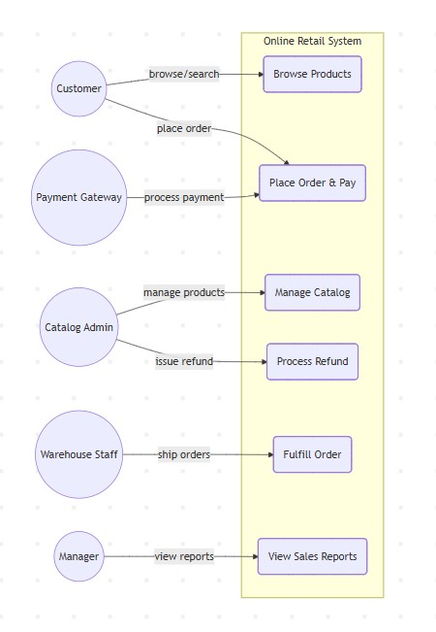
Main Use Cases and UML Diagram
UC1: Browse Products
UC2: Place Order & Pay
UC3: Manage Catalog
UC4: Fulfill Order
UC5: Process Refund
UC6: View Sales Reports

Slide 5
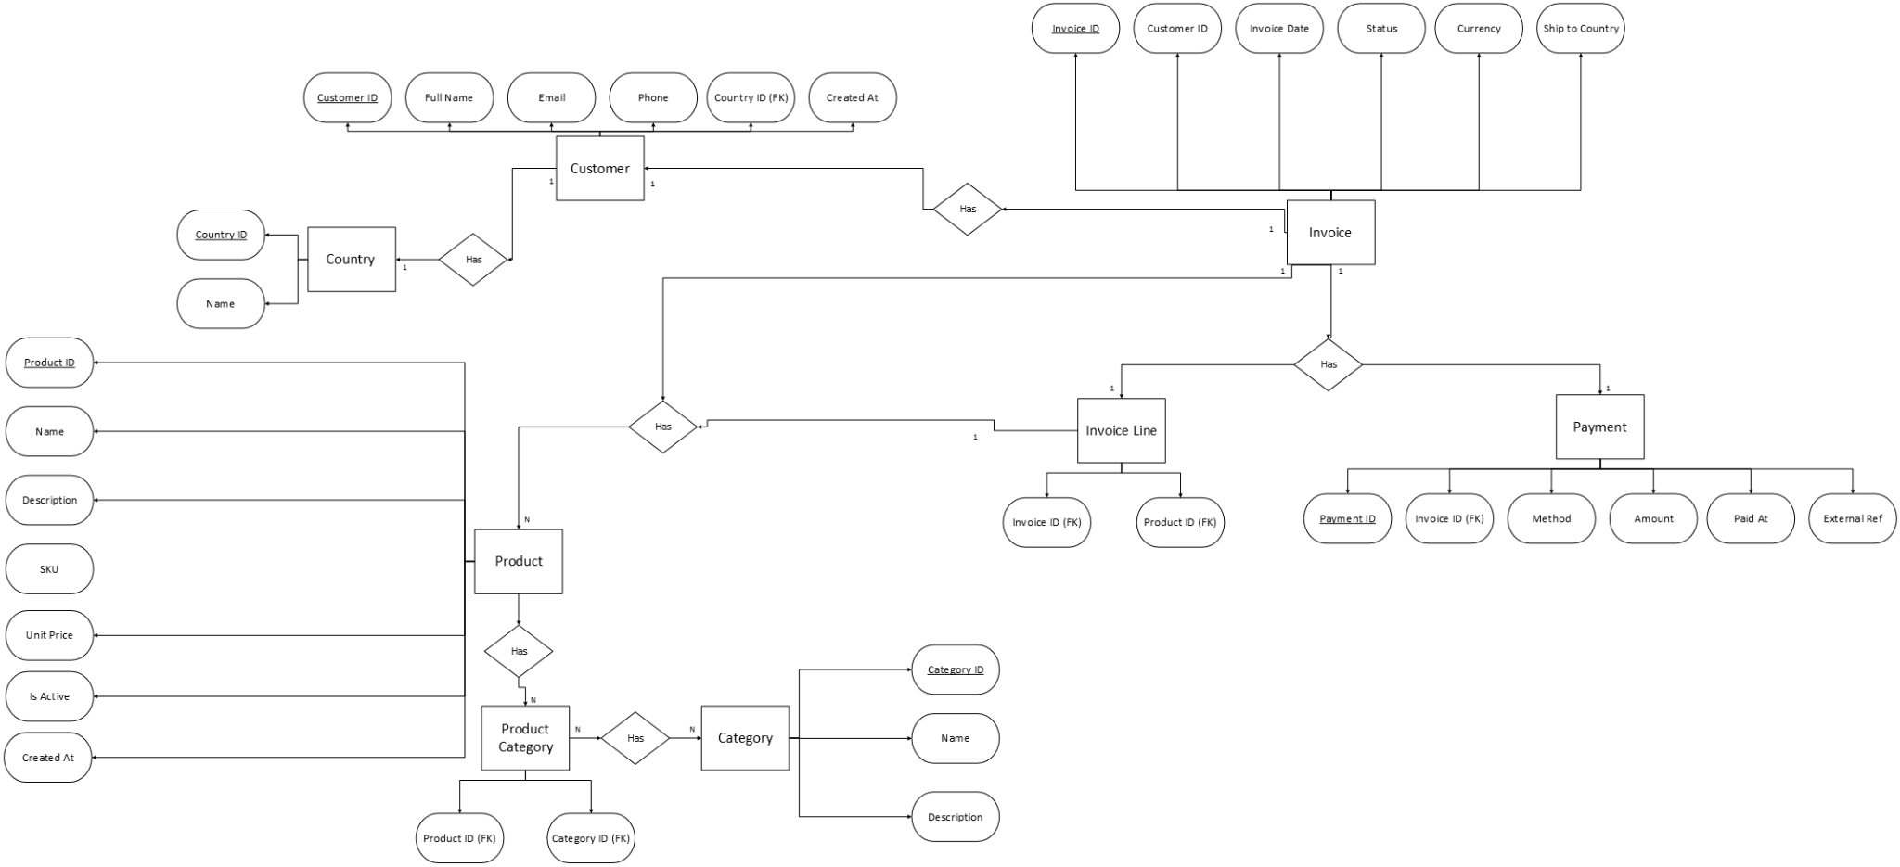
E-R Diagram

Slide 6
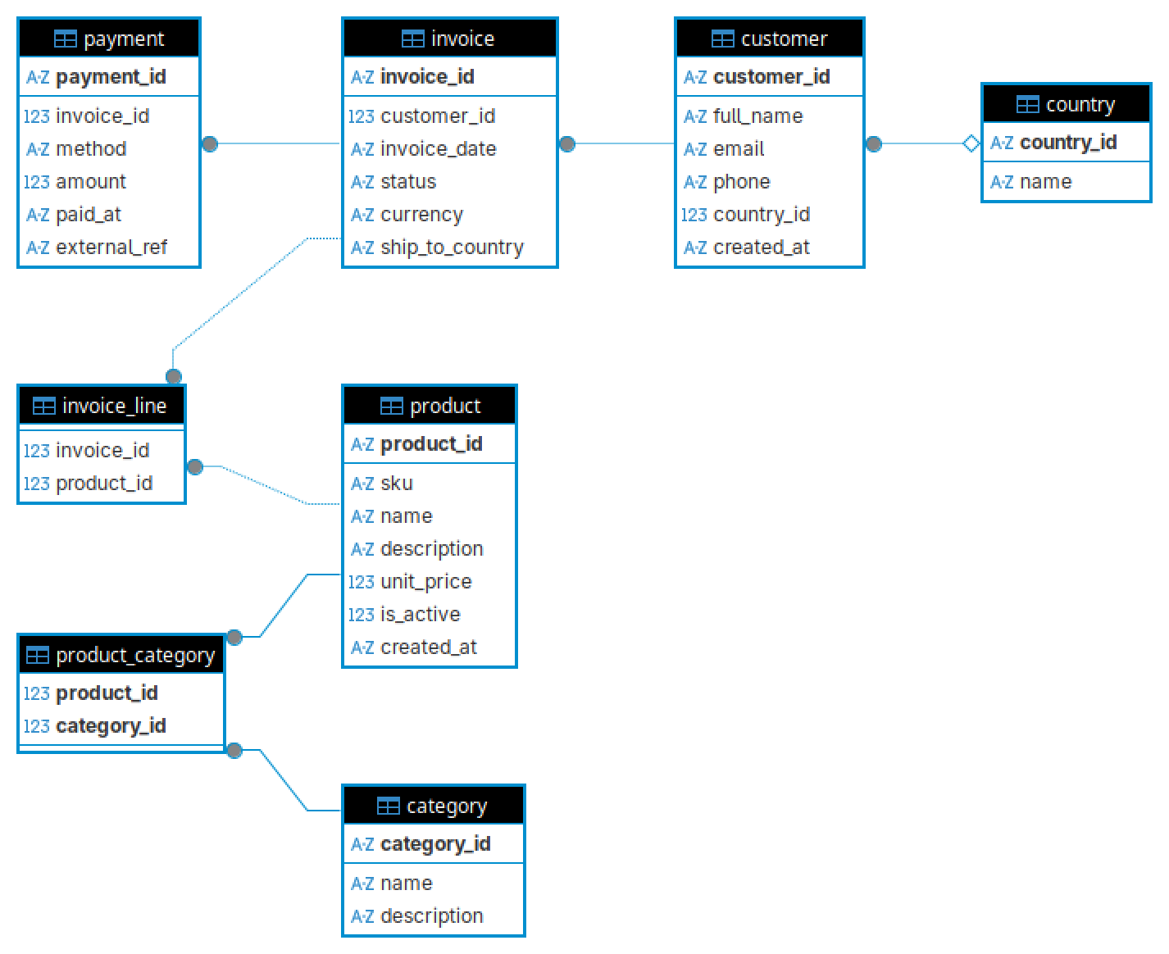
E-R Table

